Slide 1
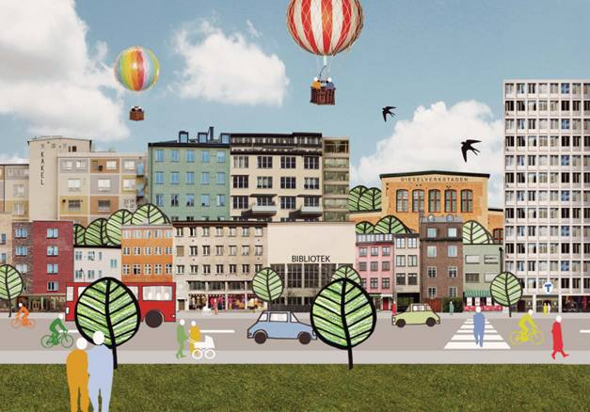
WELCOME TO NACKA CITY

Slide 2
Central Nacka
The municipality is planning for 4 600 new homes and 7 000 workplaces only 5 km from Stockholm city.

Slide 3
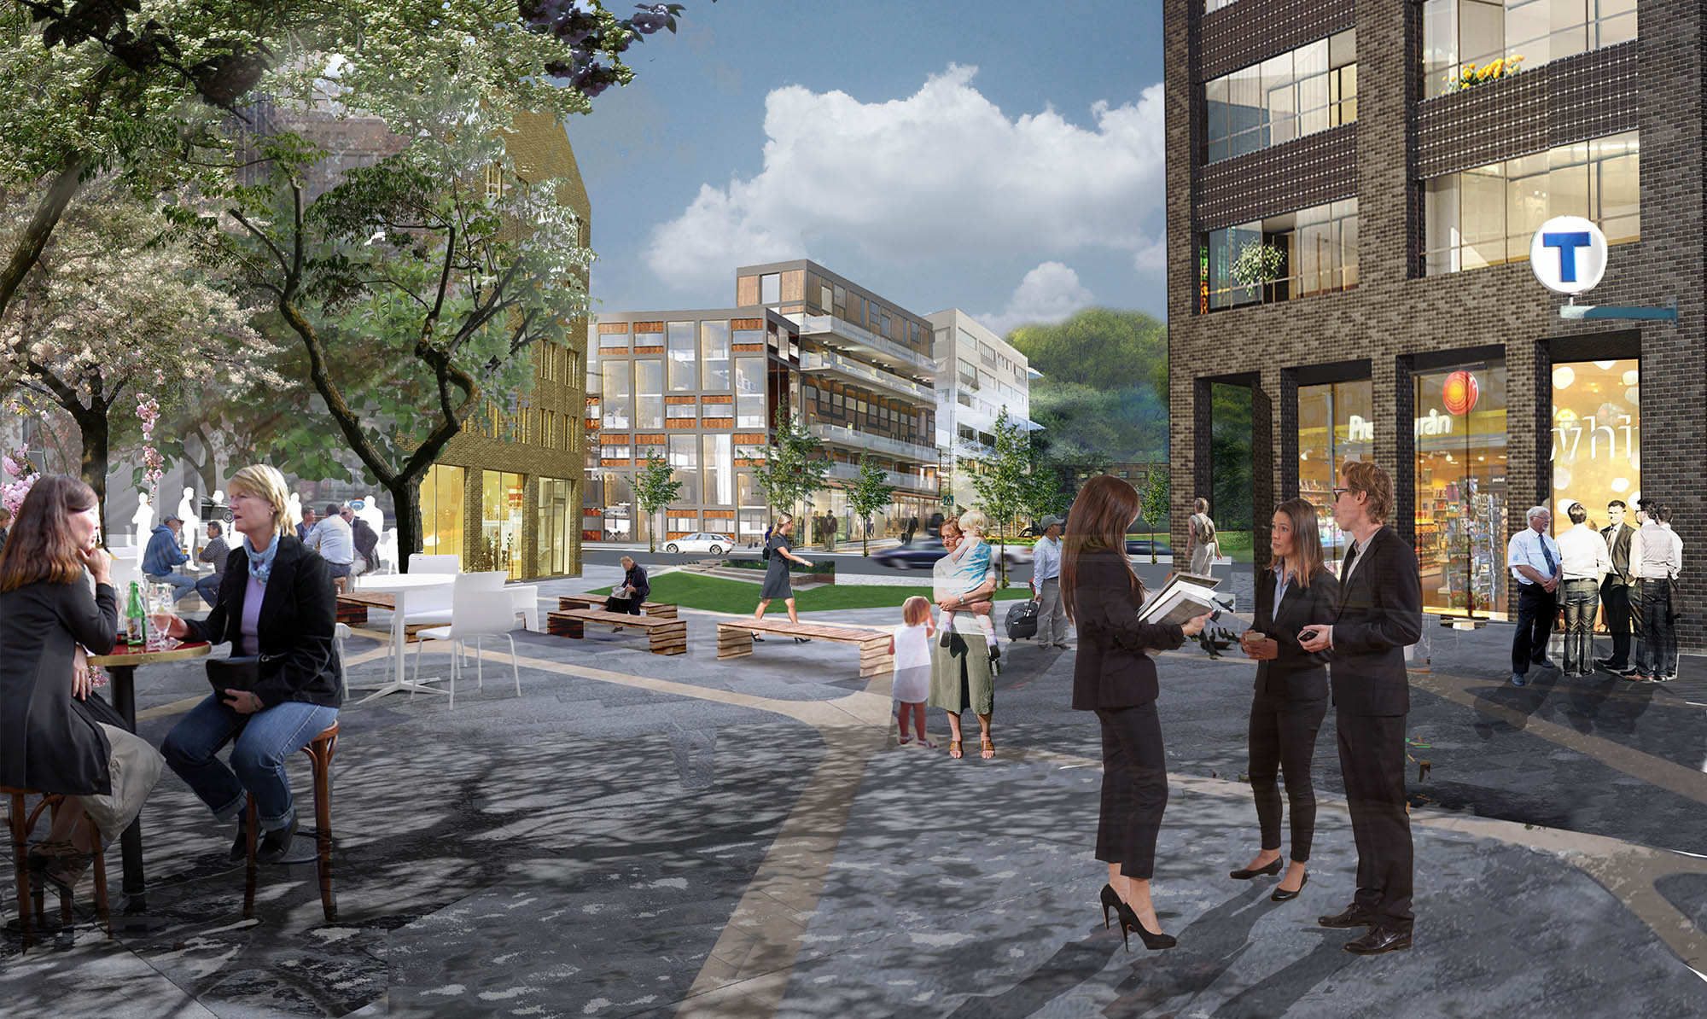
CENTRAL NACKA
A new metro line to central Nacka makes the area an important hub for transport and service.

Slide 4
CENTRAL NACKA
Sports ground in central Nacka

Slide 5
Henriksdal
The density in Henriksdal will be increased to create a more urban environment with 1,500 new homes.

Slide 6
KVARNHOLMEN
3,000 new homes and the same number of workplaces in a unique archipelago setting just 3.5 kilometres from Stockholm city.

Slide 7
KVARNHOLMEN
Stockholm Lighthouse will provide new, modernist, housing with panoramic views over the approach to Stockholm by water.

Slide 8
KVARNHOLMEN BRIDGE
The Kvarnholmen bridge will join Kvarnholmen to central Nacka.

Slide 9
EXTENDED LIGHT RAIL
The light rail line (Tvärbanan) is extended to Sickla.

Slide 10
NACKA STRAND
With 1,500 new homes, and more flexible workplaces Nacka strand will be a attractive district with a strong identity.

Slide 11
STOCKHOLM FASHION DISTRICT
In January 2016 Stockholm Showrooms will be added to Stockholm Fashion District in Nacka strand.

Slide 12
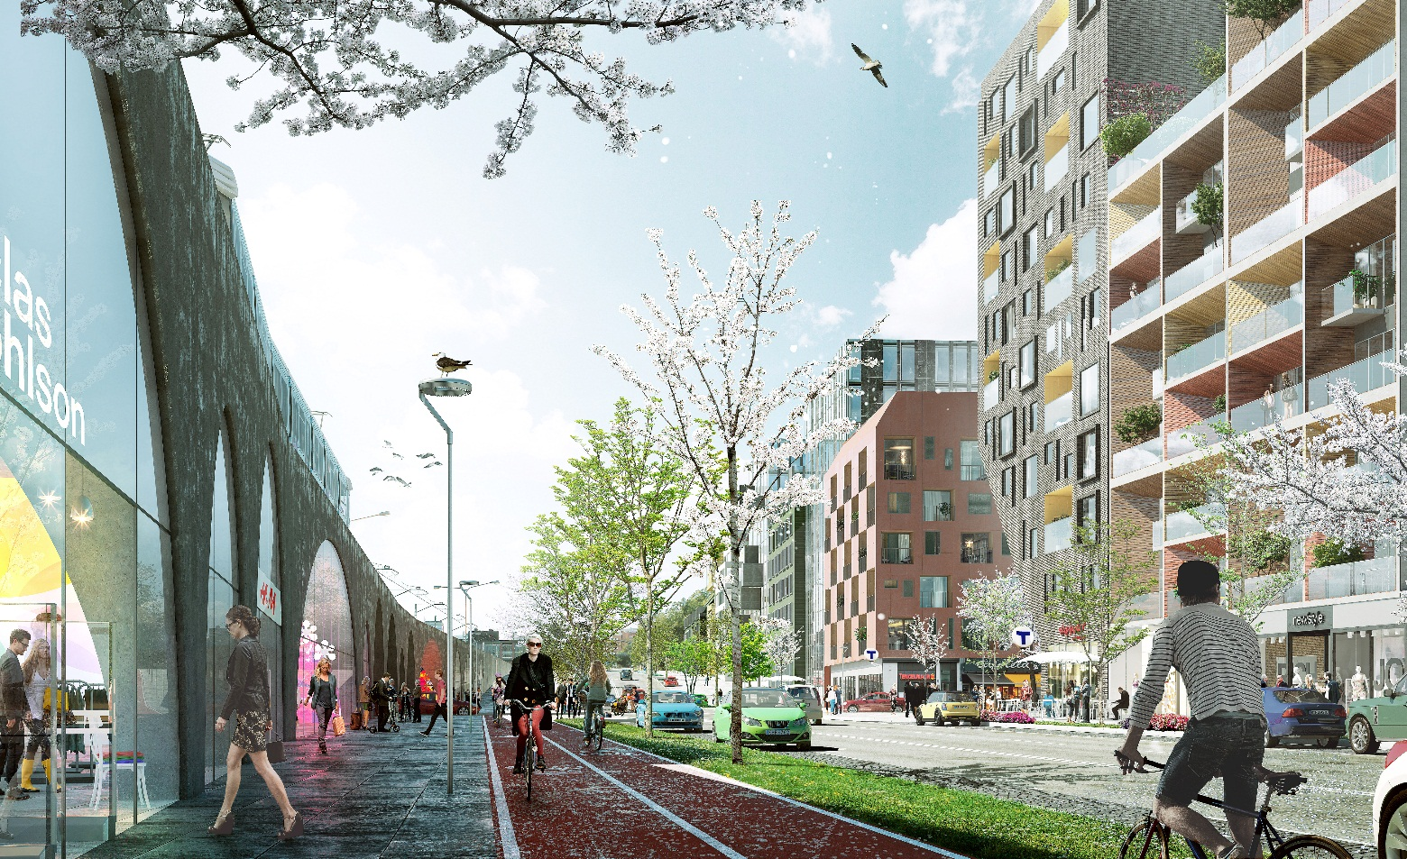
SICKLA
Close to the Sickla shopping district, Nacka is planning for 1,200 new homes.

Slide 13
ORMINGE CENTRE
Orminge centre, will be developed in to an attractive urban district.

Slide 14
ORMINGE CENTER
1,000 new homes and 30,000 square metres of space for retail, offices, culture, schools and a swimming pool.

Slide 15
THE SKURU BRIDGE
To improve traffic flow and safety on the motorway a new bridge will be built over Skurusundet.

Slide 16
ÄLTA CENTER
Älta centre will be developed into an attractive
urban district in a beautiful natural setting.

Slide 17
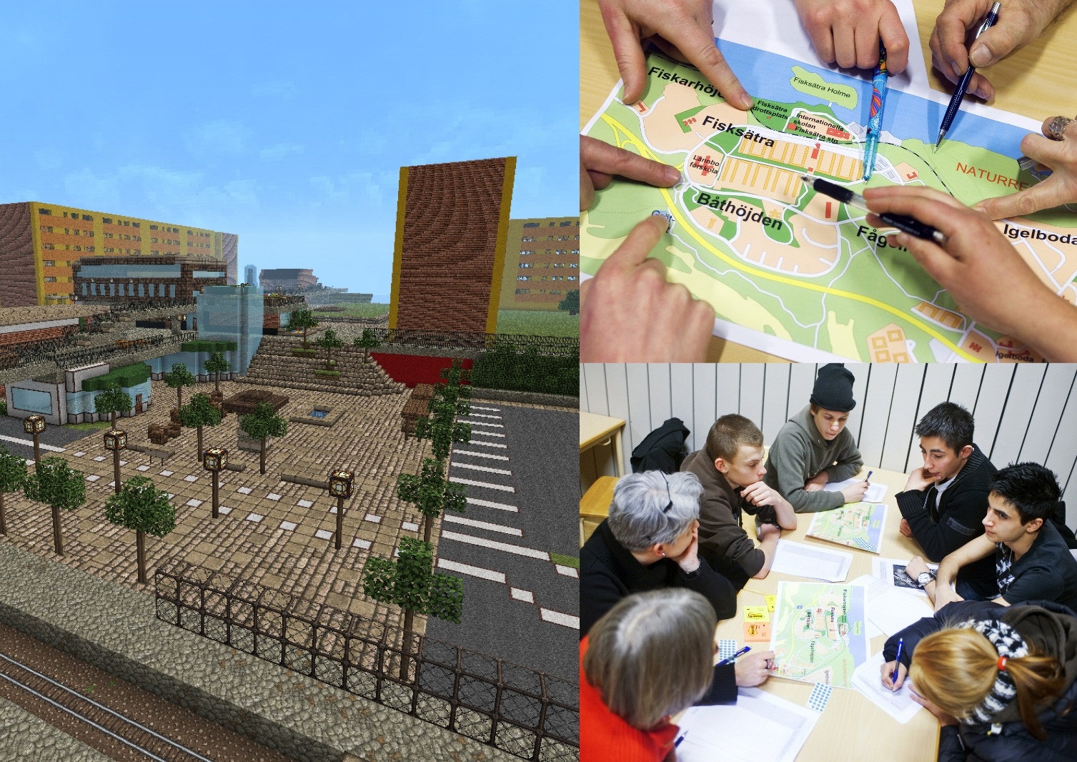
FISKSÄTRA CENTER
Residents in Fisksätra have been involved in the planning. Young people have visualized their ideas in the computer game Minecraft.

Slide 18
FISKSÄTRA MARINA
Fisksätra Marina will be a meeting place in Nacka, with boat traffic from the pier, museum, restaurant and shipbuilding.

